Slide 1
THE TEACHING PORTFOLIO AND THE TEACHING PHILOSOPHY
Mara Barbosa
Alejandra Carrillo-Muñoz

Slide 2
Today’s Objectives:
You will…
Identify appropriate and effective strategies to present evidence of teaching effectiveness.
Plan, compose, develop and craft a teaching portfolio.
Write/revise a teaching statement/philosophy based on search committees’ general demands.

Slide 3
Today’s Agenda
1. Pre-survey & Introductions
2. Intro: “What is a teaching portfolio”
3. The components of a teaching portfolio
4. Intro “The teaching philosophy”
5. The components of a teaching philosophy
6. Summary & post-workshop survey

Slide 4
Please take this time to fill in the pre-survey

Slide 5
The Teaching Portfolio
“The teaching portfolio is a relatively short collection of materials and artifacts selected to document, summarize, and highlight
one’s growth, experiences, and strengths
as a teacher”
https://www.gradschool.unh.edu/pdf/pff_portfolio.pdf
A Guide to the Electronic Teaching Portfolio Academic Programs in College Teaching
University of New Hampshire Durham, NH 03824
Notes:
Does this mean that you are not to mention your research? – No! If you can create connections between your research and your teaching, highlight them!

Slide 6
Teaching Portfolio Continued
The process of selecting and organizing material for a portfolio can help one reflect on and improve one’s teaching.
Portfolios can offer a look at development over time, helping one see teaching as on ongoing process of inquiry, experimentation, and reflection.
Portfolios are a step toward a more public, professional view of teaching as a scholarly activity.
Center for Teaching at Vanderbilt University
http://cft.vanderbilt.edu/guides-sub-pages/teaching-portfolios/#what

Slide 7
Why a Teaching Portfolio?
Job applicants use teaching portfolios to document their teaching effectiveness.
Faculty members up for promotion or tenure can document their teaching effectiveness.
Faculty members and teaching assistants can “go public”, especially those online
invite comments from their peers
share teaching successes so that their peers can build on them
Center for Teaching at Vanderbilt University
http://cft.vanderbilt.edu/guides-sub-pages/teaching-portfolios/#what

Slide 8
The Teaching Portfolio
MUST contain
Teaching Philosophy
Objective evaluations
Subjective evaluations
Course syllabi (prospective)
Samples of student work
Courses taught
Achievements
MAY contain
Examples of lessons
Video clip documenting teaching
Teaching goals

Slide 9
Get Started on Your Teaching Portfolio
Never too Early! Many components are difficult (if not impossible) to obtain after a course has been taught
Be true to yourself. Highlight the positive, but don’t completely omit the negative
Be selective. Represent a cross-section of your teaching. Not just one aspect.
Organize for your reader. Use a table of contents.
Context & explanation. Describe the course, the students, and, if used the lesson plan. Also include a reflection on how well it worked.
Center for Teaching at Vanderbilt University
http://cft.vanderbilt.edu/guides-sub-pages/teaching-portfolios/#what

Slide 11
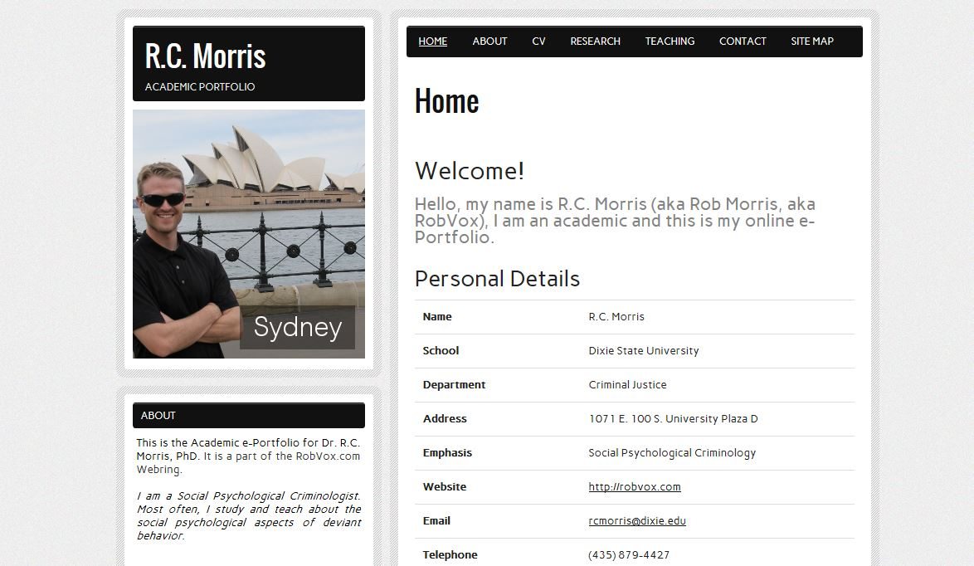

Slide 12
Teaching Philosophy
What is it?
Self-reflective
Concise (1-4)
Descriptive of your beliefs about teaching and learning (the most important ones)
Descriptive of how you put your beliefs in practice
Ever-changing

Slide 13
How to Get Started
There are as many ways to write a Teaching Philosophy as there are writers. Some initial tips include:
Brainstorming
Reading examples
Answering some crucial questions:
What do you teach?
Why do you teach?
How do you teach?
How do you know you are achieving your teaching objectives?

Slide 14
Teaching Philosophy
What else?:
Be specific with content
Show self-reflection
Be descriptive and detailed
Avoid jargon for clarity purposes

Slide 15
Teaching Philosophy
Activity:
From the list in your handout, select the 10 that are most important to you
Now narrow selection to the top 3 that are most important
Decide on the one, most important term
Move into a group that shares your priorities
Work together to explain and report ways in which you would implement those beliefs in the classroom
(adapted from Ann Marie, Iowa State University)

Slide 16
Teaching Philosophy Peer Review
Give your teaching philosophy to the person on your right (don’t have one? –raise your hand and you will receive a teaching philosophy from the CIE)
Read and evaluate the teaching philosophy you received according to the rubric
Ask the author for permission to share good examples that demonstrate effectiveness

Slide 17
Objective Teaching Evaluations
Present it in a concise way
Explain what you are showing
Highlight how you score well on items that you have highlighted in you teaching philosophy

Slide 18
Subjective Teaching Evaluations
From students:
Explain where the comments come from (all from one year, selected from different years…)
Organize them (maybe group them by theme)
From coordinators:
Explain the objective of the courses in which you were observed.
Explain the conditions that were evaluated

Slide 19
(Prospective) course syllabi
Include a syllabus that you have created and implemented, accompanied by a short statement contextualizing it, and evaluating how well it worked when it was used
Never had to design a course? Write a syllabus for a course you have taught or are likely to teach as a Professor

Slide 20
Samples of Student Work
This might be a photocopy of a student paper, with marginalia and an end comment evaluating the essay or report as a whole.
Contextualize it
Ask for permission to use it, ALWAYS!

Slide 21
Courses Taught
List of courses you have taught:
Name and number
School
Your responsibilities
Number of students
Course description
Learning objectives

Slide 22
Achievements
List any of the following to you have received:
Certificates
Awards

Slide 23
Sources
Lang, James M. "4 Steps to a Memorable Teaching Philosophy. The Chronicle of Higher Education. August 29, 2010.http://chronicle.com/article/5-Steps-to-a-Memorable/124199/
Center for research on learning and teaching – University of Michigan http://www.crlt.umich.edu/tstrategies/tstpts
Center for Teaching at Vanderbilt University
http://cft.vanderbilt.edu/guides-sub-pages/teaching-portfolios/#what

